Slide 1
Standard Functions in C
C provides a rich collection of standard functions whose definitions have been written and are ready to be used in our programs. To use these functions, we must include their function declarations.
Topics discussed in this section:
Math Functions
Random Numbers

Slide 2
Library Functions and the Linker

Slide 3
Some functions #include<stdlib.h> abs() int = abs(int) rand() srand() Others: malloc, qsort, etc.

Slide 4
Math functions #include <math.h> trig: cos(), etc. pow(base, exp); log, exp, etc. sqrt() ceil(), floor(), trunc(), round(), etc.

Slide 5
Ceiling Function

Slide 6
Floor Function

Slide 7
Random Number Generation

Slide 8
Generating a Random Number Series

Slide 9
Note
srand must be called only once for each random number series.

Slide 10
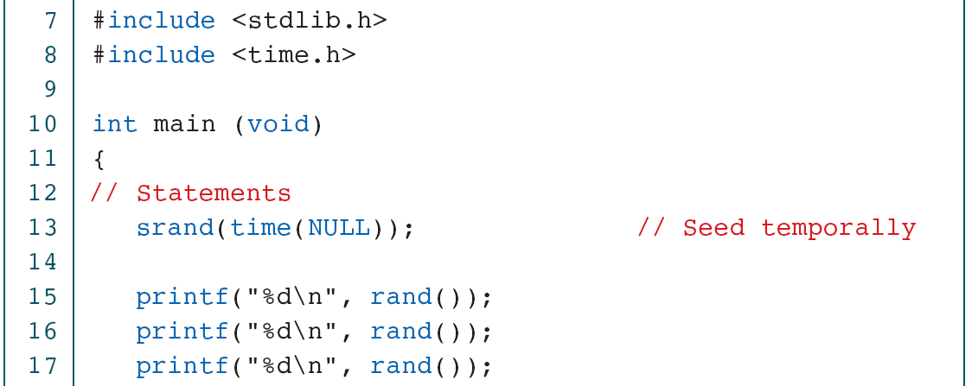
Creating Temporal Random Numbers

Slide 11
Creating Temporal Random Numbers

Slide 12
Creating Pseudorandom Numbers

Slide 13
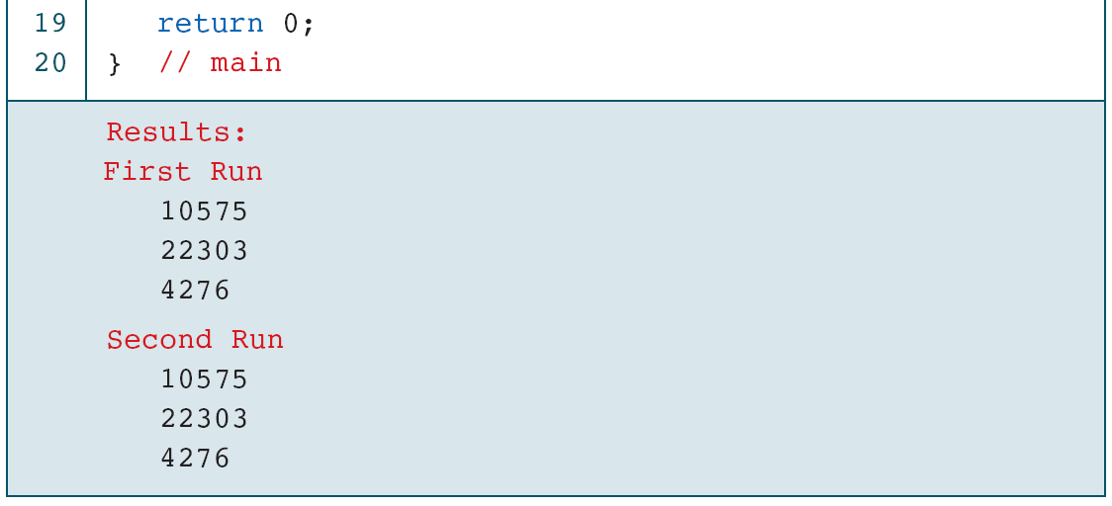
Creating Pseudorandom Numbers

Slide 14
Random Number Scaling for 3–7

Slide 15
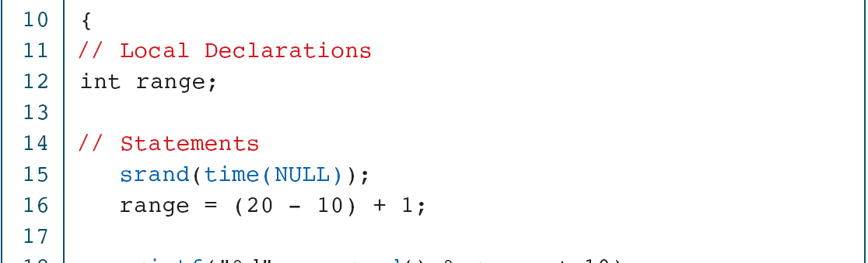
Generating Random Numbers in the Range 10 to 20

Slide 16
Generating Random Numbers in the Range 10 to 20

Slide 17
Generating Random Real Numbers

Slide 18
Generating Random Real Numbers

